Slide 1

Shark Memory Dump
--Implementation & Analysis
Author：Dongming Yang

Slide 2

Contents
1. Memory Dump Flow
2. Memory Dump Implementation
3. Memory Files Analysis
4. Q & A
. <number>

Slide 3
1. Memory Dump Flow
Work flow
Kernel Panic
HW watchdog
reset
reset
uboot
dump memory？
no
yes
dump to SD
Start linux
. <number>

Slide 4
1. Memory Dump Flow
What will result in memory dump ?
  Kernel exceptions
    panic()
    die()
    emergency_restart()
. <number>

Slide 5
1. Memory Dump Flow
What will result in memory dump ?
  Crash key
    force a kernel panic invoked
    volume up + volume down + 2 times power key down
  System request
    $ echo c > /proc/sysrq-trigger
    It will force a panic
. <number>

Slide 6
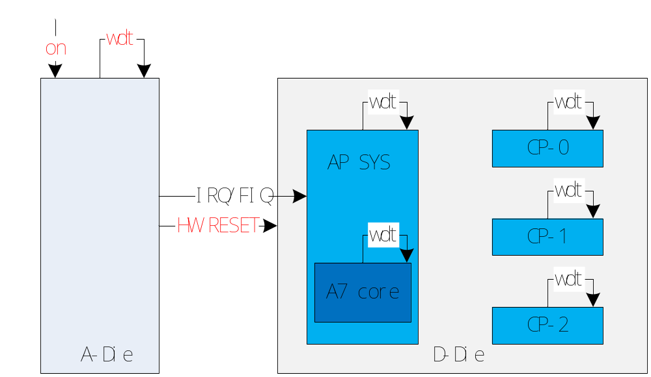
1. Memory Dump Flow
What will result in memory dump ?
  HW watchdog timeout
    5 D-die watchdogs, 1 A-die watchdog
. <number>

Slide 7
1. Memory Dump Flow
What will result in memory dump ?
  HW watchdog timeout
    Cortex-A7 watchdog
      Reset CortexA7 core
    AP-sys watchdog
      Reset the whole AP system domain, CPU cores, caches, I/O controllers, etc
    A-Die watchdog
      Reset the whole system, similar to power onDDR, IRAM, bus monitor registers kept
. <number>

Slide 8
1. Memory Dump Flow
What will result in memory dump ?
  HW watchdog timeout
    root@android:/sys/module/sprd_wdt_sys/parameters # ls
    -ap_margin , 12s, reset ap side
    -ca7_irq_margin , 9s, irq triggered, call panic at last
    -ca7_margin , 10s, reset ca7 core
    -chip_margin , 15s, reset the whole SOC system
    -enabled , 1 enable (default), 0 disable
    -feed_period , 3s, the feed frequency
. <number>

Slide 9
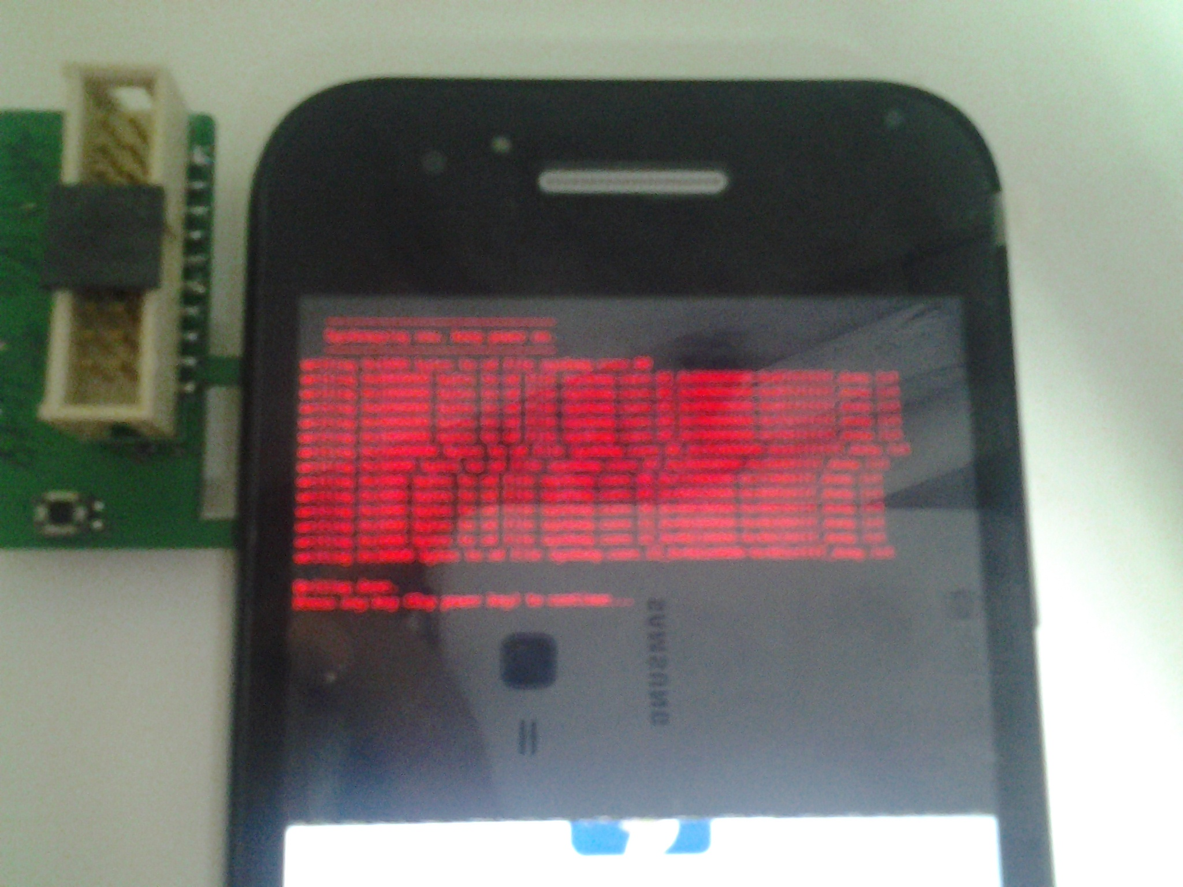
1. Memory Dump Flow
Memory Dump Screen
  Uboot dump file list
  Press key to continue
. <number>

Slide 10
Contents
1. Memory Dump Flow
2. Memory Dump Implementation
3. Memory Files Analysis
4. Q & A
. <number>

Slide 11
2. Memory Dump Implementation
Kernel
  Crash key & schedule log
    kernel/arch/arm/mach-sc/sprd_debug.c
  Sysdump
    kernel/arch/arm/kernel/sprd_sysdump.c
U-boot
  Check reset mode & dump memory to SD card
    u-boot/property/sysdump.c
. <number>

Slide 12
2. Memory Dump Implementation
Crash key
  kernel/drivers/input/input.c
static void input_handle_event(…)
{
……
case EV_KEY:
#if defined(CONFIG_SPRD_DEBUG)
if(code != BTN_TOUCH)
sprd_debug_check_crash_key(code ,value);
#endif
. <number>

Slide 13
2. Memory Dump Implementation
Schedule log
  kernel/arch/arm/mach-sc/include/mach/sprd_debug.h
#define SCHED_LOG_MAX 1024
#define CP_DEBUG
struct sched_log {
struct task_log {
unsigned long long time;
#ifdef CP_DEBUG
unsigned long sys_cnt;
#endif
char comm[TASK_COMM_LEN];
pid_t pid;
} task[NR_CPUS][SCHED_LOG_MAX];
struct irq_log {
unsigned long long time;
#ifdef CP_DEBUG
unsigned long sys_cnt;
#endif
int irq;
void *fn;
int en;
} irq[NR_CPUS][SCHED_LOG_MAX];
. <number>

Slide 14
2. Memory Dump Implementation
Schedule log
  kernel/arch/arm/mach-sc/include/mach/sprd_debug.h
#define SCHED_LOG_MAX 1024
#define CP_DEBUG
struct sched_log {
struct work_log {
unsigned long long time;
#ifdef CP_DEBUG
unsigned long sys_cnt;
#endif
struct worker *worker;
struct work_struct *work;
work_func_t f;
} work[NR_CPUS][SCHED_LOG_MAX];
struct hrtimer_log {
unsigned long long time;
#ifdef CP_DEBUG
unsigned long sys_cnt;
#endif
struct hrtimer *timer;
enum hrtimer_restart (*fn)(struct hrtimer *);
int en;
} hrtimers[NR_CPUS][8];
};
. <number>

Slide 15
2. Memory Dump Implementation
Schedule log
  kernel/arch/arm/mach-sc/sprd_debug.c
  schedule logs are stored in struct sprd_debug_log
static struct sched_log (*psprd_debug_log) = (&sprd_debug_log);
. <number>

Slide 16
2. Memory Dump Implementation
Sysdump
  2 entry places
    die()
void die(const char *str, struct pt_regs *regs, int err)
{
struct thread_info *thread = current_thread_info();
int ret;
enum bug_trap_type bug_type = BUG_TRAP_TYPE_NONE;
oops_enter();
raw_spin_lock_irq(&die_lock);
console_verbose();
bust_spinlocks(1);
if (!user_mode(regs))
bug_type = report_bug(regs->ARM_pc, regs);
if (bug_type != BUG_TRAP_TYPE_NONE)
str = "Oops - BUG";
ret = __die(str, err, thread, regs);
#ifdef CONFIG_SPRD_SYSDUMP
sysdump_enter(1, str, regs);
#endif
. <number>

Slide 17
2. Memory Dump Implementation
Sysdump
  2 entry places
    panic()
void panic(const char *fmt, ...)
{
……
console_verbose();
bust_spinlocks(1);
va_start(args, fmt);
vsnprintf(buf, sizeof(buf), fmt, args);
va_end(args);
printk(KERN_EMERG "Kernel panic - not syncing: %s\n",buf);
#ifdef CONFIG_DEBUG_BUGVERBOSE
/*
* Avoid nested stack-dumping if a panic occurs during oops processing
*/
if (!test_taint(TAINT_DIE) && oops_in_progress <= 1)
dump_stack();
#endif
#ifdef CONFIG_SPRD_SYSDUMP
sysdump_enter(0, buf, NULL);
#endif
. <number>

Slide 18
2. Memory Dump Implementation
Sysdump
  Procedure of sysdump_enter()
save cpu context
(core, mmu)
These info should be written into Reserved Memory Address, used by both kernel and u-boot, to avoid overwritten during reboot process.
flush cache
sysdump_prepare_info
(partition info, elf hdr)
emergency_restart
. <number>

Slide 19
2. Memory Dump Implementation
Disable crash key & schedule log
  Use command in adb shell:
    echo 0 > /sys/module/sprd_debug/parameters/enable
Disable sysdump
  Use command in adb shell:
    echo 0 > /proc/sys/kernel/sysdump_enable
Sysdump only for Crash key reboot
  Use command in adb shell:
    echo 1 > /proc/sys/kernel/sysdump_crashkey_only
. <number>

Slide 20
2. Memory Dump Implementation
U-boot
  do memory dump check before boot kernel
    u-boot/property/cmd_cboot.c
int do_cboot(cmd_tbl_t *cmdtp, int flag, int argc, char *const argv[])
{
uint32_t key_mode = 0;
uint32_t key_code = 0;
volatile int i;
unsigned rst_mode= check_reboot_mode();
……
#ifdef CONFIG_SPRD_SYSDUMP
write_sysdump_before_boot(rst_mode);
#endif
//normal boot procedure
. <number>

Slide 21
2. Memory Dump Implementation
U-boot
  Reset mode
    arch/arm/cpu/armv7/sc8830/check_reboot.c
unsigned check_reboot_mode(void)
{
unsigned rst_mode= 0;
rst_mode = ANA_REG_GET(ANA_REG_GLB_POR_RST_MONITOR);
rst_mode &= 0x7FFF;
ANA_REG_SET(ANA_REG_GLB_POR_RST_MONITOR, 0); //clear flag
printf("rst_mode==%x\n",rst_mode);
……
}
. <number>

Slide 22
2. Memory Dump Implementation
U-boot
  Reset mode
    WATCHDOG_REBOOT: HW watchdog reboot
    UNKNOW_REBOOT_MODE: includes 7s power key reset
#define RECOVERY_MODE 0x77665502
#define FASTBOOT_MODE 0x77665500
#define NORMAL_MODE 0x77665503
#define ALARM_MODE 0x77665504
#define SLEEP_MODE 0x77665505
#define WATCHDOG_REBOOT 0x77665506
#define SPECIAL_MODE 0x77665507
#define UNKNOW_REBOOT_MODE 0x77665508
#define PANIC_REBOOT 0x77665509
#define CALIBRATION_MODE 0x7766550a
#define AUTODLOADER_REBOOT 0x77665510
. <number>

Slide 23
2. Memory Dump Implementation
U-boot
  Procedure of write_sysdump_before_boot()
HW watchdog or
Unknown reboot ?
yes
no
Create ELF header
Create ELF header
Dump the whole memory
to one single file
Dump memory according to
the stored partition info
Nand kernel boot
. <number>

Slide 24
2. Memory Dump Implementation
U-boot
  Panic reboot mode
    |-- sysdump.core.00
    |-- sysdump.core.01_0x80000000-0x87ffffff_dump.lst
    |-- sysdump.core.02_0x88000000-0x897fffff_dump.lst
    |-- sysdump.core.03_0x89800000-0x8fffffff_dump.lst
    |-- sysdump.core.04_0x90000000-0x93ffffff_dump.lst
    |-- sysdump.core.05_0x94000000-0x94ffffff_dump.lst
    |-- sysdump.core.06_0x95000000-0xbfffffff_dump.lst
    |-- sysdump.core.07_0x20d00000-0x20d0ffff_dump.lst
    |-- sysdump.core.08_0x71400000-0x71400fff_dump.lst
    |-- sysdump.core.09_0x40050000-0x40050fff_dump.lst
    |-- sysdump.core.10_0x40030000-0x40030fff_dump.lst
    |-- sysdump.core.11_0x40280000-0x40280fff_dump.lst
    |-- sysdump.core.12_0x40210000-0x40210fff_dump.lst
    |-- sysdump.core.13_0x402e0000-0x402effff_dump.lst
ELF header file
Raw memory file
Peripheral registers
. <number>

Slide 25
2. Memory Dump Implementation
U-boot
  HW Watchdog & Unknown reboot mode
    |-- sysdump.core.00
    |-- sysdump.core.01_0x80000000-0xbfffffff_dump.lst
ELF header file
Raw memory file
kernel could have halted on these conditions,
so the ELF header would be created by u-boot.
. <number>

Slide 26
Contents
1. Memory Dump Flow
2. Memory Dump Implementation
3. Memory Files Analysis
4. Q & A
. <number>

Slide 27
3. Memory File Analysis
Memory files location
  the “.lst” memory files are in sdcard root directory
  On PC side, there is androidlog tools which can pull the memory files along with other logs, stored in the “sysdump” folder inside the slog files.
. <number>

Slide 28
3. Memory File Analysis
Analyze with TRACE32
  Install Trace32-ICD
  Merge the split memory files into one single ELF file
    For Ubuntu, use
    $: cat sysdump.core* >> sysdump.core
    For windows, use:
    C:\>type sysdump.core* > sysdump.core
. <number>

Slide 29
3. Memory File Analysis
Analyze with TRACE32
  Use the following test script to load memory file
  start Trace32, use cmd: $ t32 -s ./startup.cmm
; startup.cmm stript
system.cpu cortexa5
system.memaccess cpu
system.cpuaccess enable
system.mode up
task.config /home/apuser/workspace/trace32/linux.t32
menu.reprogram /home/apuser/workspace/trace32/linux.men
help.filter.add rtoslinux
;method 1: load each partition file
;d.load.binary sysdump.core.01_0x80000000-0x87ffffff_dump.lst 0xc0000000
;d.load.binary sysdump.core.02_0x88000000-0x897fffff_dump.lst 0xc8000000
;d.load.binary sysdump.core.03_0x89800000-0x8fffffff_dump.lst 0xc9800000
;d.load.binary sysdump.core.04_0x90000000-0x93ffffff_dump.lst 0xd0000000
;d.load.binary sysdump.core.05_0x94000000-0x94ffffff_dump.lst 0xd4000000
;d.load.binary sysdump.core.06_0x95000000-0xbfffffff_dump.lst 0xd5000000
;method 2: load a single ELF core dump file
d.load.core sysdump.core /noclear
d.load.elf ../vmlinux /nocode
Also we can load the split memory file to virtual address one by one
. <number>

Slide 30
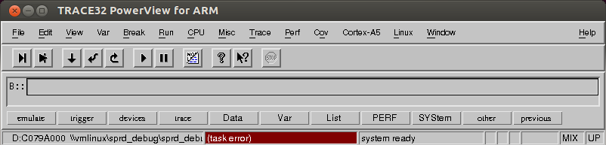
3. Memory File Analysis
Analyze with TRACE32
  Trace32 screen
. <number>

Slide 31
3. Memory File Analysis
Analyze with TRACE32
  Load vmlinux using cmdline:
  d.load.elf ./vmlinux /nocode “kernel” /sourcepath /kernel
  Load binary memory file:
  d.load.binary ./SDRAM_AP_0x94500000--0xafffffff.lst 0xc4500000
  Load core dump memory file
  d.load.core sysdump.core /noclear
. <number>

Slide 32
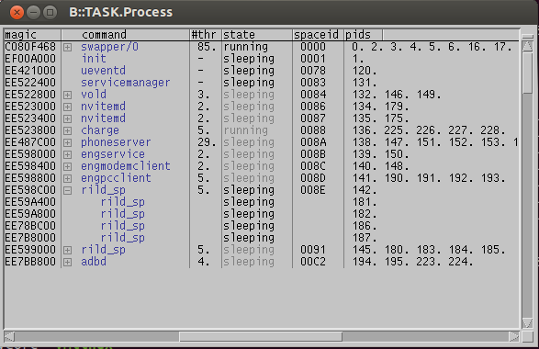
3. Memory File Analysis
Analyze with TRACE32
  List tasks using cmdline:
  B::TASK.Process
. <number>

Slide 33
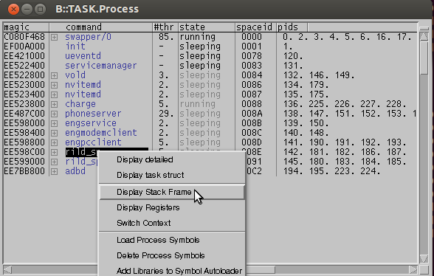
3. Memory File Analysis
Analyze with TRACE32
  List tasks using cmdline:
  Show stack frame and register by right click on each process
. <number>

Slide 34
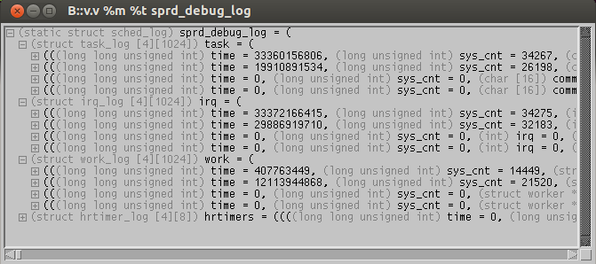
3. Memory File Analysis
Analyze with TRACE32
  View schedule log info using cmdline:
  B::v.v %m %t sprd_debug_log
CONFIG_PHYS_OFFSET
. <number>

Slide 35
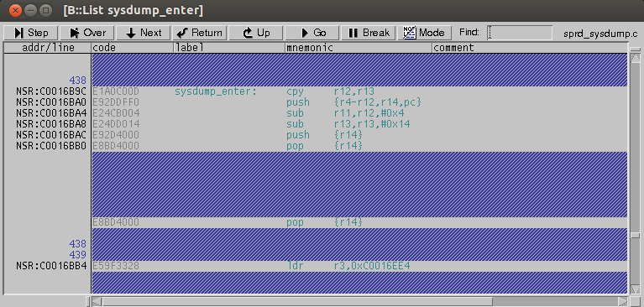
3. Memory File Analysis
Analyze with TRACE32
  View function using cmdline:
  B::List sysdum_enter
. <number>

Slide 36
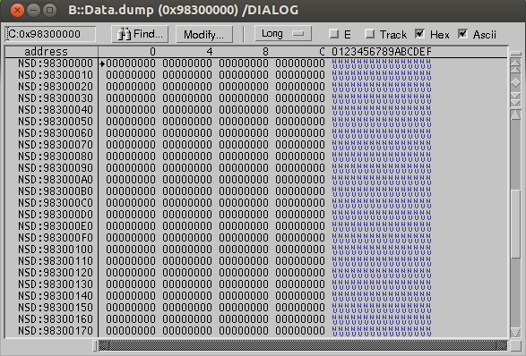
3. Memory File Analysis
Analyze with TRACE32
  Data dump using cmdline:
  B::Data.dump 0x98300000 /DIALOG
. <number>

Slide 37
3. Memory File Analysis
Analyze with TRACE32
  Data kernel log using cmdline:
  d.save.binary kernel.log __log_buf++0xfffff
. <number>

Slide 38
3. Memory File Analysis
Analyze with TRACE32
  More usage please refer to “icd_tutorial.pdf” and other files in pdf folder included in the installation path.
. <number>

Slide 39
3. Memory File Analysis
Analyze with Other Tools
  Crash
    http://people.redhat.com/anderson/crash_whitepaper/#COMMAND_LINE
  GDB
. <number>

Slide 40


